Slide 1
HOUSE OF HACKERS
Problem Statement Title :
Create a device that can detect a driver’s sleepy eyes and send an alert to the driver while also slowing down the vehicle
Team Name : CBUDZZ
Institute code (AISHE): C-15716
Institute Name : N. B. Navale Sinhgad College Of Engineering, Solapur

Slide 2
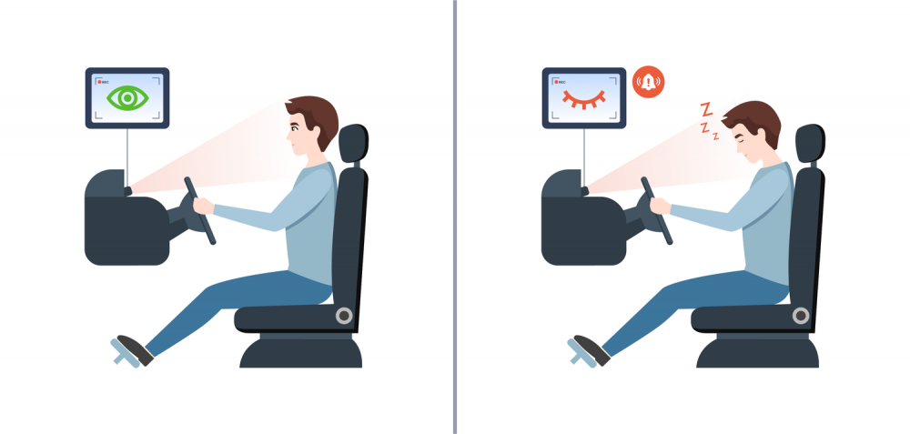
IDEA APPROACH / DETAILS
Sleepy Eye Detection Device for Drivers
Problem Statement
Sleepy drivers cause accidents
Device to detect drowsy driving
Sends alerts to driver
Need for real-time detection and intervention
Key Features
Eye-tracking technology
Advanced cameras
Infrared sensors
Detects eye closure and blink rate
Facial expression analysis
Machine learning algorithms
Identifies signs of drowsiness
Analyzes yawning and head nodding
Driver alert system
Audible alarms
Dashboard warning lights
4. Benefits
Improved road safety
Reduced fatigue-related accidents
Enhanced driver well-being
Potential Challenges
System reliability
Driver privacy concerns
Compatibility with various vehicle models
Tech Stack:
Python 3.x
OpenCV
Dlib
Scikit-learn
Twilio
URLlib

Slide 3
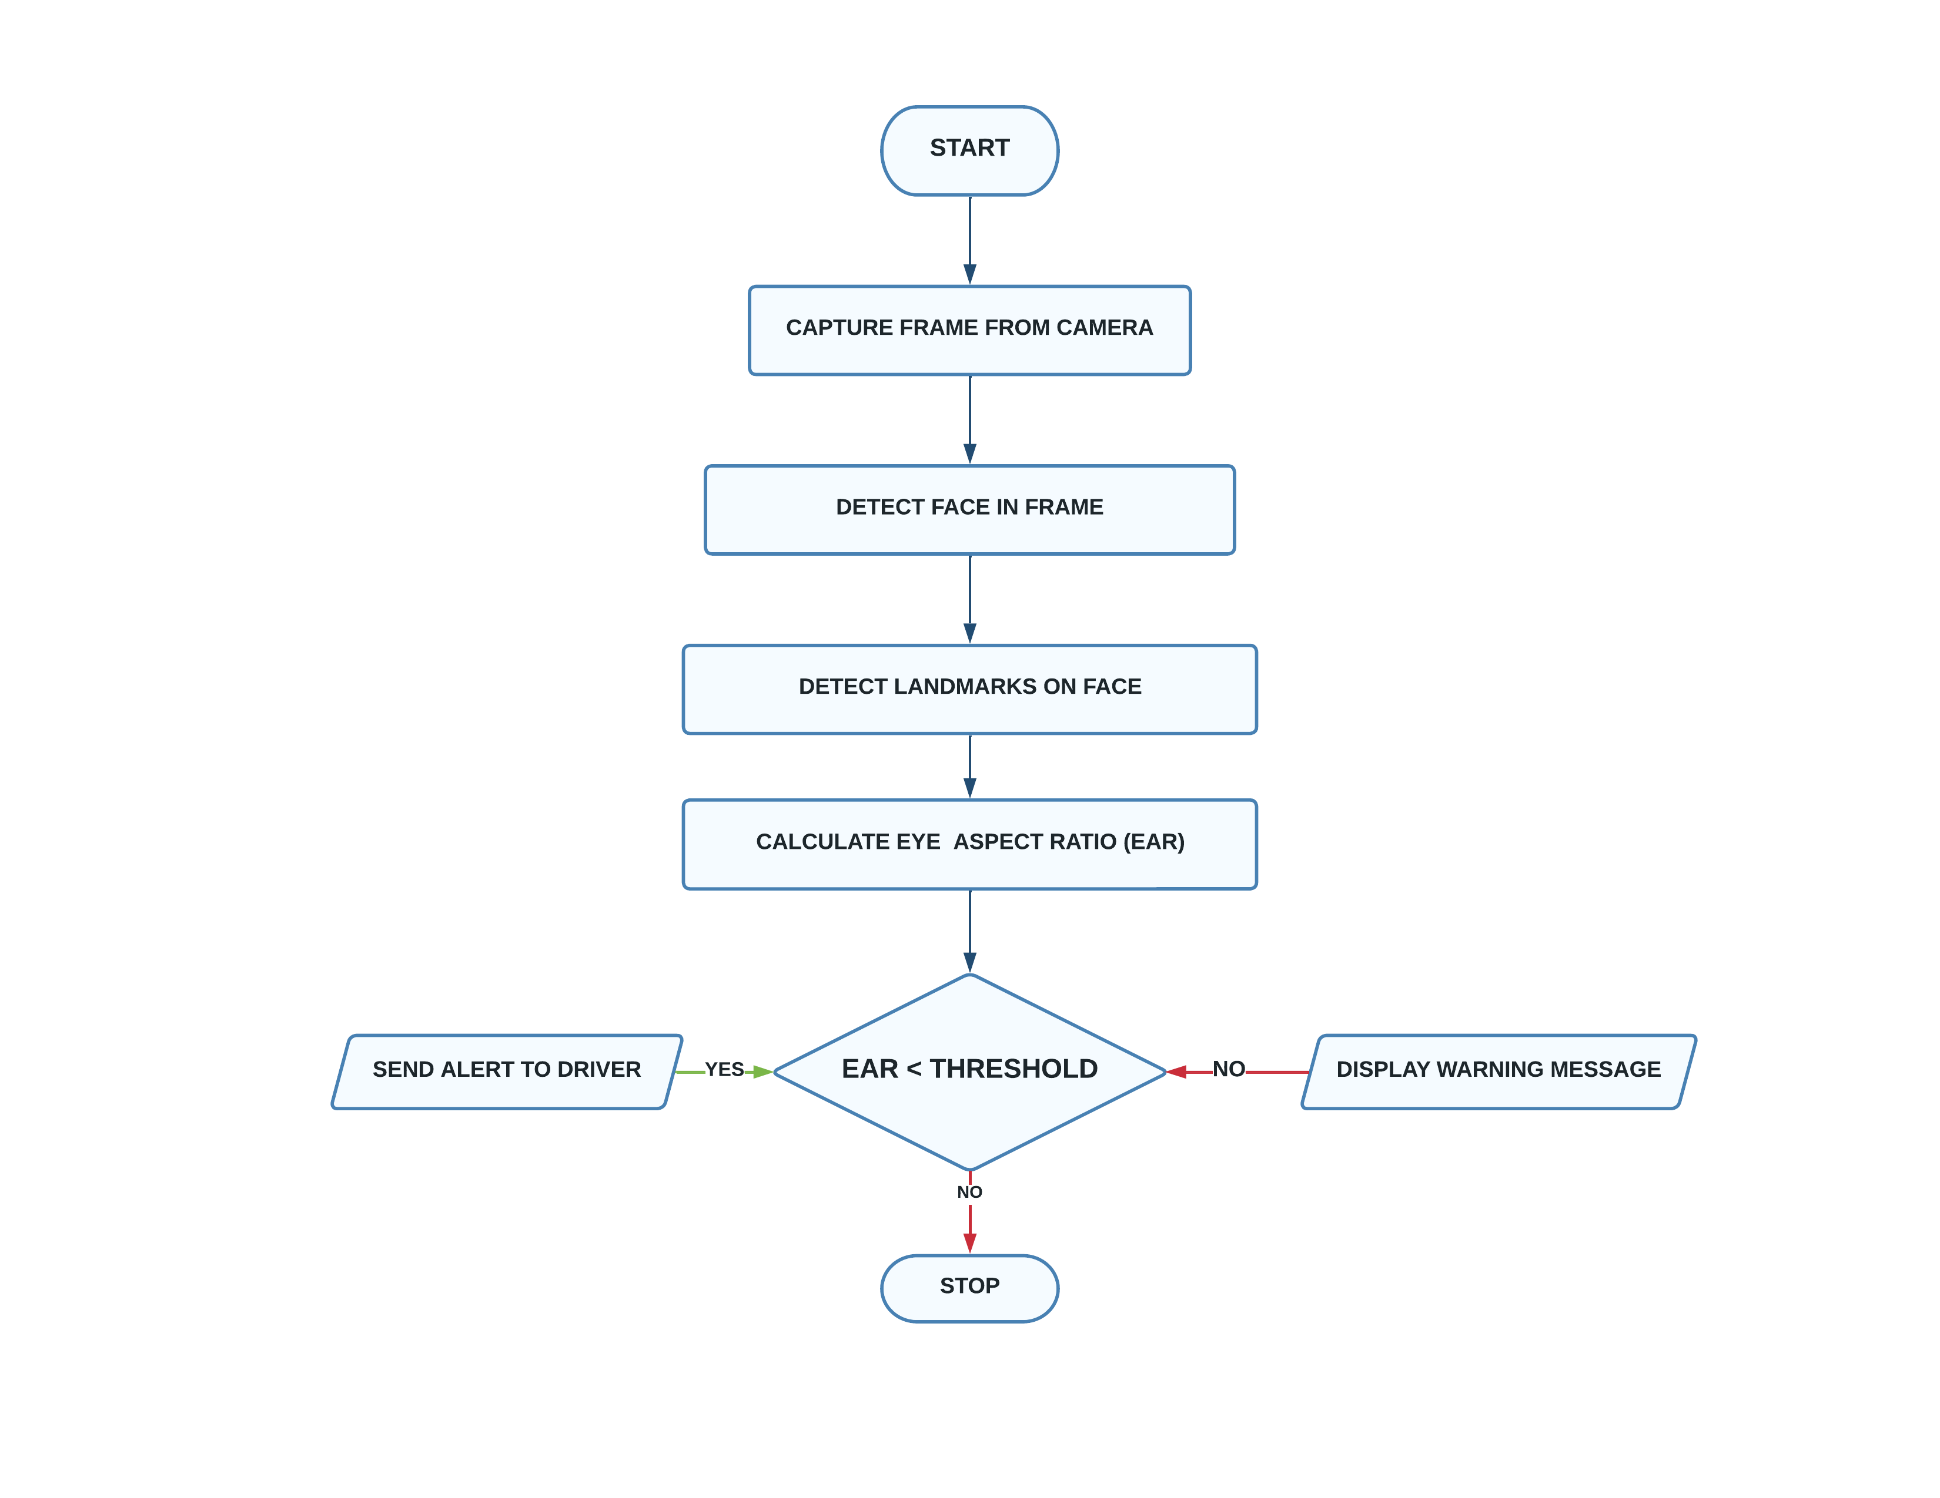
Working of the Code and Flowchart :
The code will continuously capture frames from the camera and perform the following steps:
Detect the Eyes in the frame using a pre-trained Eye detection model from Dlib.
Detect the landmarks on the face (such as eyes, nose, mouth, etc.) using a pre-trained facial landmark detection model from Dlib.
Calculate the Eye Aspect Ratio (EAR) for both eyes using the formula: EAR = (|p2-p6| + |p3-p5|) / 2|p1-p4|, where p1-p6 are the six landmark points on the eye region.
If the EAR value for both eyes falls below a certain threshold (indicating that the eyes are closed or almost closed), then the driver is considered to be sleepy.
In that case, the code will send an alert to the driver (such as a buzzer sound or a Phone Call)

Slide 4
Team Member Details :
Sr. No. | Name of Team Member | Branch (Btech): | Stream (CSE): | Year | Position In Team
1 | Harshvardhan Konda | BTech | CSE | Third-Year | Team Leader
2 | Nouman Chitapure | BTech | CSE | Third-Year | Front End
3 | Mustafa Masuldar | BTech | CSE | Third-Year | Back End
4 | Md Arafat Nadaf | BTech | CSE | Third-Year | Back End

